Slide 1

EMPLOYEE MANAGEMENT SYSTEM

Slide 2

TEAM MEMBERS
P. Sai Laxmana Vignesh
Ajay Kumar Mahto
N. Sai Sudhamsh
B. Pranay Kumar
A. Pradeepa
M. Srija

Slide 3

PROJECT INTRODUCTION
For
Purpose of the project is to create a “Employee Management System” which sorts the administrators.
They include administrative functions.
This can be used by anyone with required technology.
Administrators are allowed to search and insert edit update Employees Details.

Slide 4
Contd…
For small businesses this may Cost them plenty.
To make cost effective and User friendly. We came up with this.
Administrators are allowed to search and insert edit update Employees Details.
Employee Management is now getting crucial.

Slide 5

REQUIREMENTS
Software Requirements
Windows 10 version.
A browser which supports CGI, HTML & JavaScript.
Front-end software: Angular.
Back-end software: Spring boot.
Database: Oracle database.

Slide 6
REQUIREMENTS
Hardware Requirements
Processor : AMD Ryzen 5 PRO 3500U w/ Radeon Vega Mobile Gfx,2100 Mhz, 4 Core(s), 8 Logical Processor(s)
RAM : 128 MB
Hard Disk : 10 GB

Slide 7



Used Tools and Technologies
Frontend- Angular
Backend- Spring Tool
Oracle Database
Online Tools
Word
PowerPoint

Slide 8
Advantages
AVAILABILITY: The flight should be available on the specified date and specified time as Admin may need it any time.
CORRECTNESS: Correct data should be displayed.
MAINTAINABILITY: The administrators should maintain correct data.
USABILITY: Can be used by Admin.

Slide 9

Disadvantages OF EXISITING SYSTEM
Difficultly in maintenance.
Security issues.
Misplaced.
Required more human resources.
More time consumption.
Errors cannot be rectified.

Slide 10
PROPOSED SYSTEM
Employee Details: The new proposed system stores and maintains all the employee's details.
Registers: There is no need of keeping and maintaining salary and employee register manually.
Speed: The new proposed system is very fast with 100% accuracy and saves time.
Manpower: The new proposed system needs less manpower. Less people can do the large work.

Slide 11
ADVANTAGES OF PROPOSED SYSTEM
Less manpower consumption.
Easy future reference.
Option to save the details in database.
Easy to check the details.
Security of data and overcome the disadvantages of existing systems.
Utilized for easy documenting and accessing various data carries such as records.

Slide 12
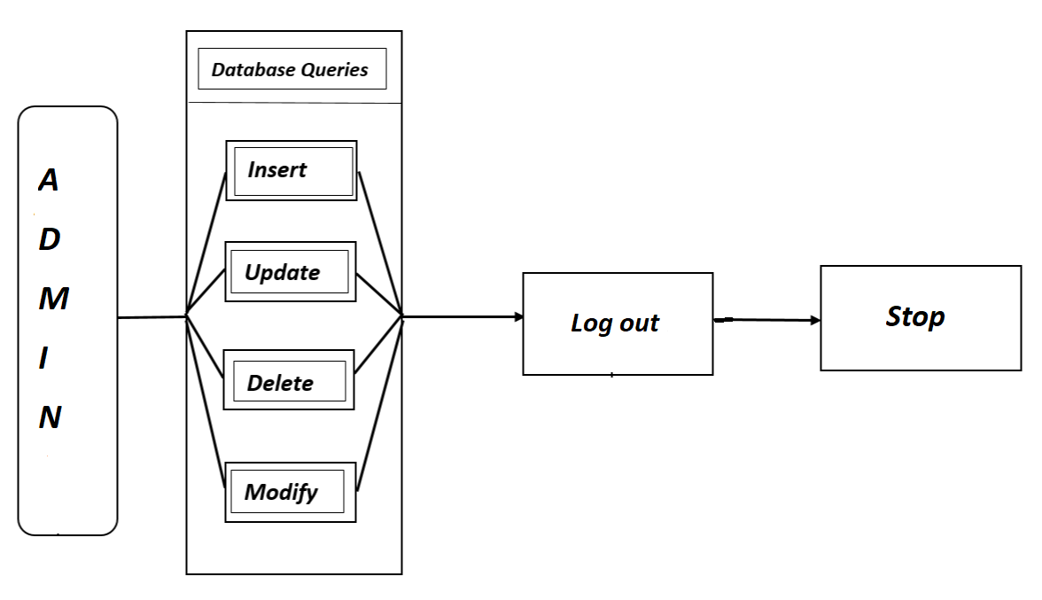
ADMIN CASE DIAGRAM

Slide 13
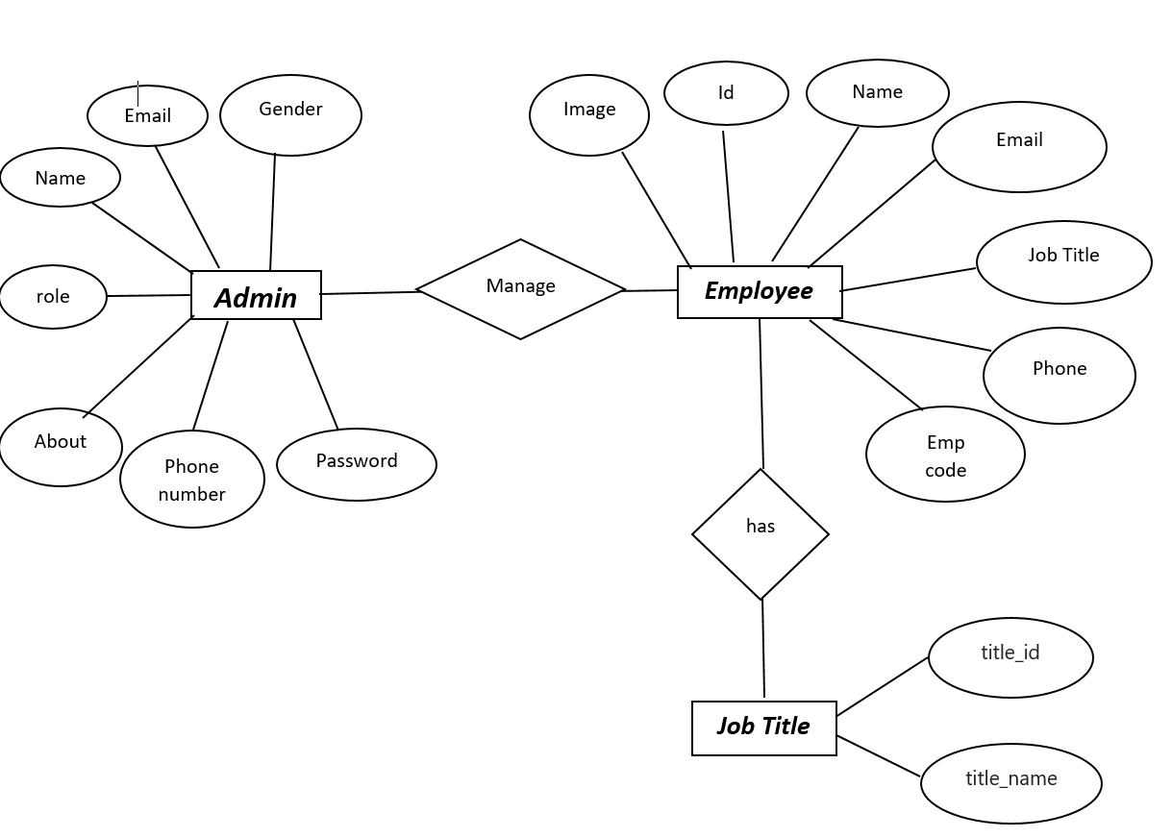
ER DIAGRAM

Slide 14
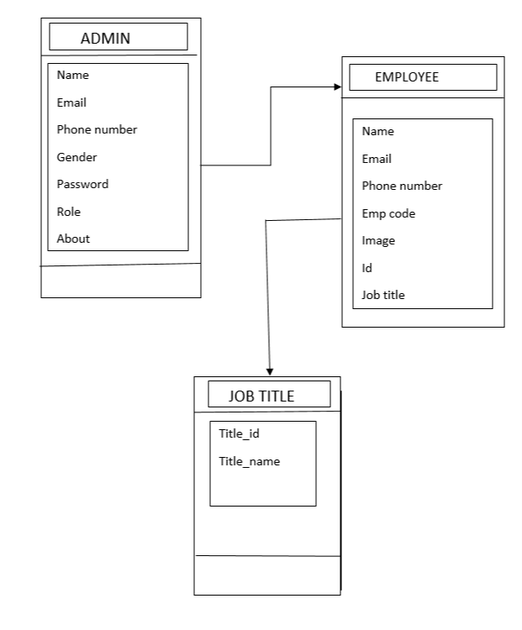
ACITVITY DIAGRAM

Slide 15
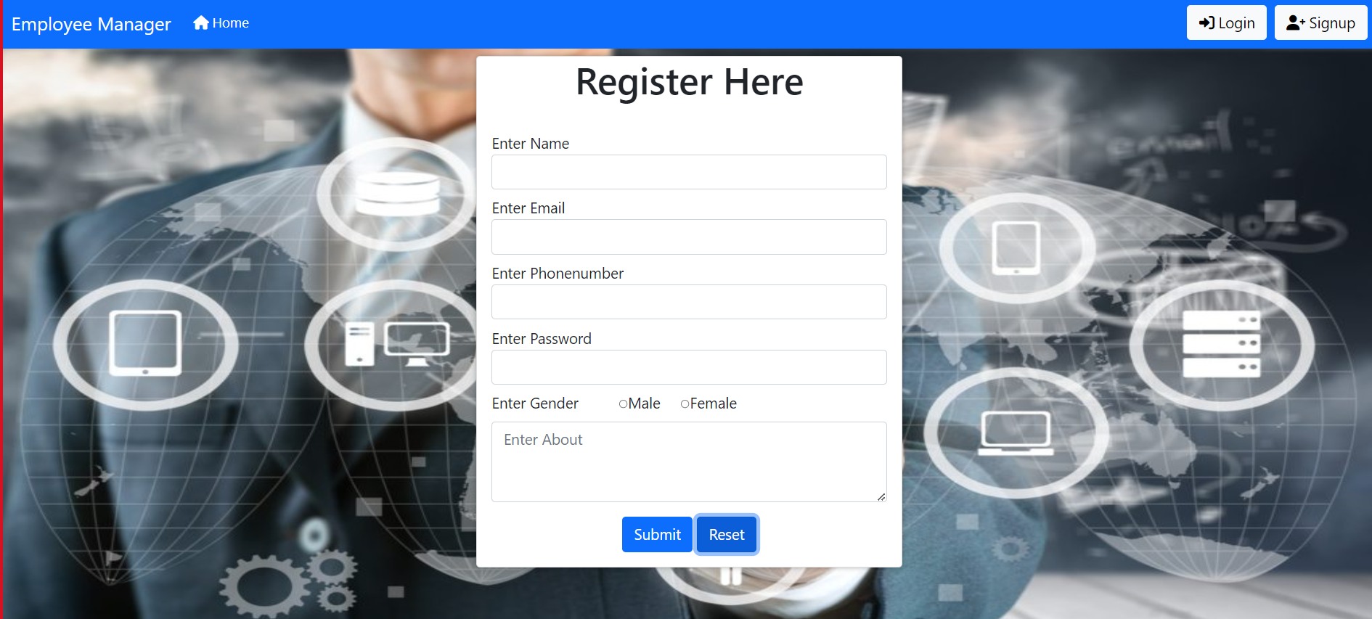
Registration Form

Slide 16
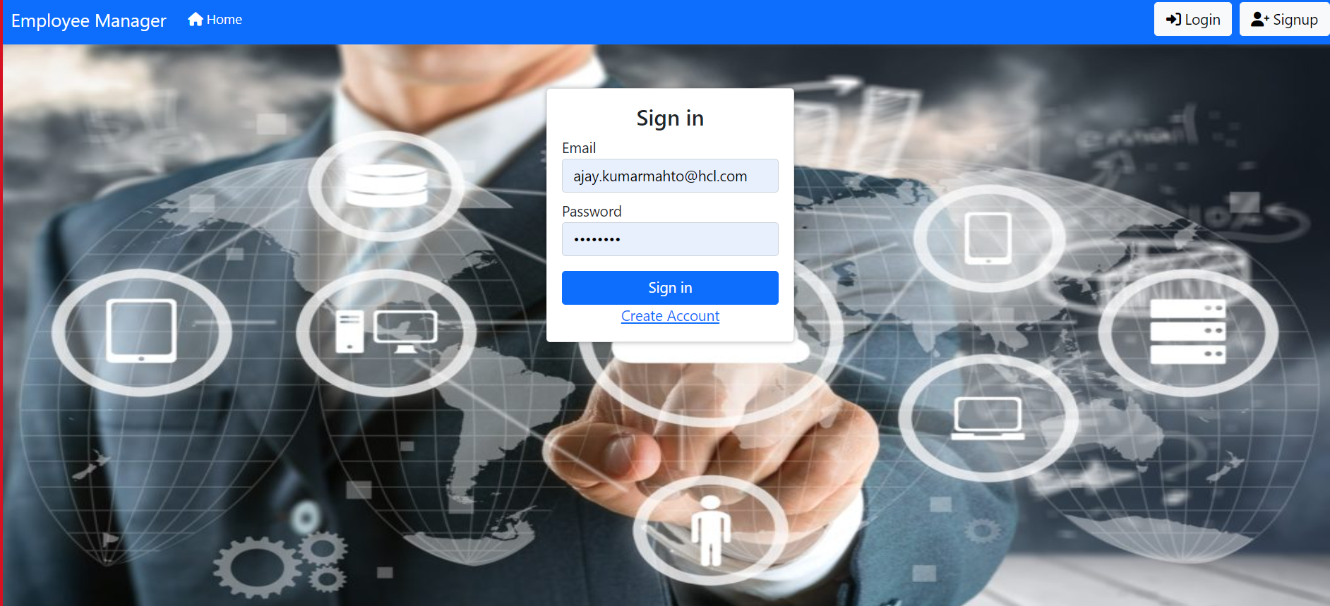
LOGIN

Slide 17
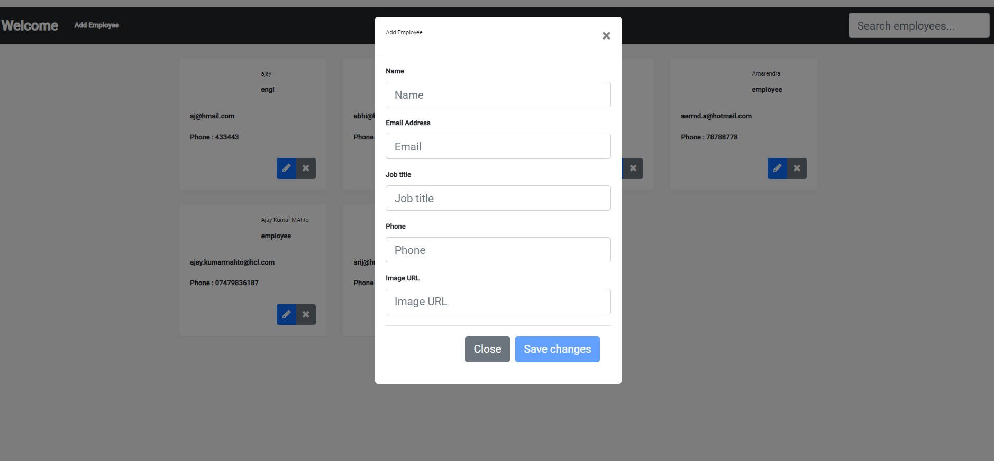
Adding-Employee

Slide 18
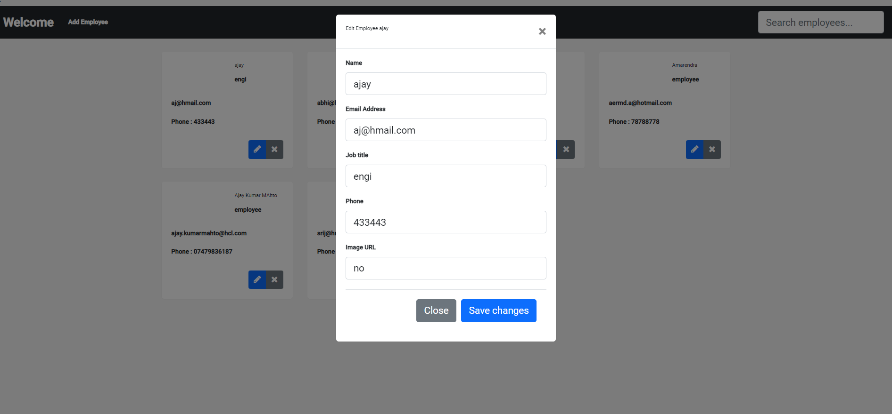
Edit-Employee

Slide 19
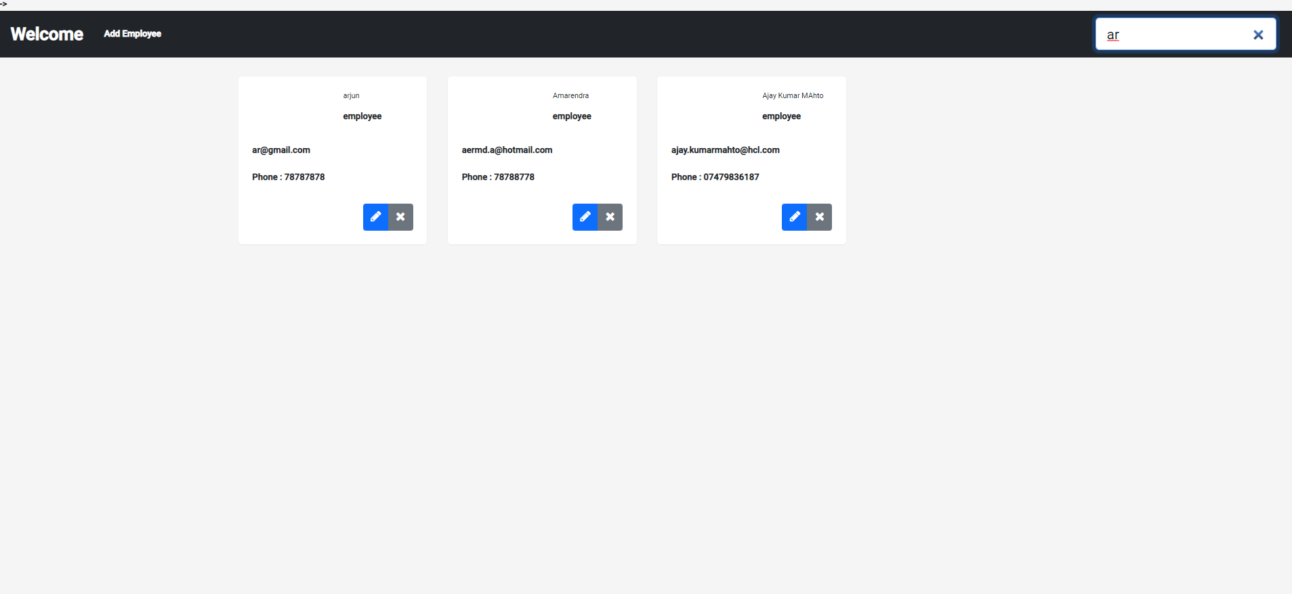
Search-Employee

Slide 20
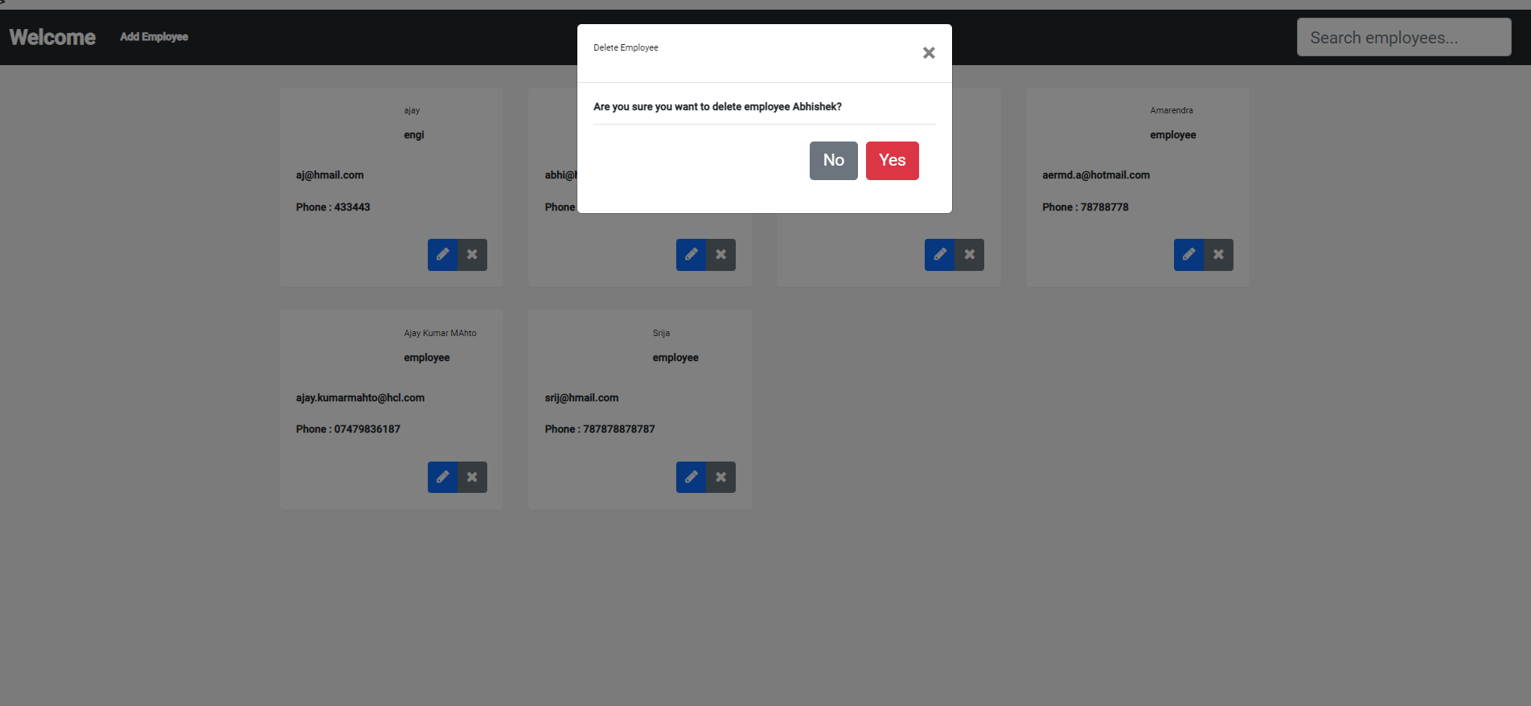
Delete-Item

Slide 21
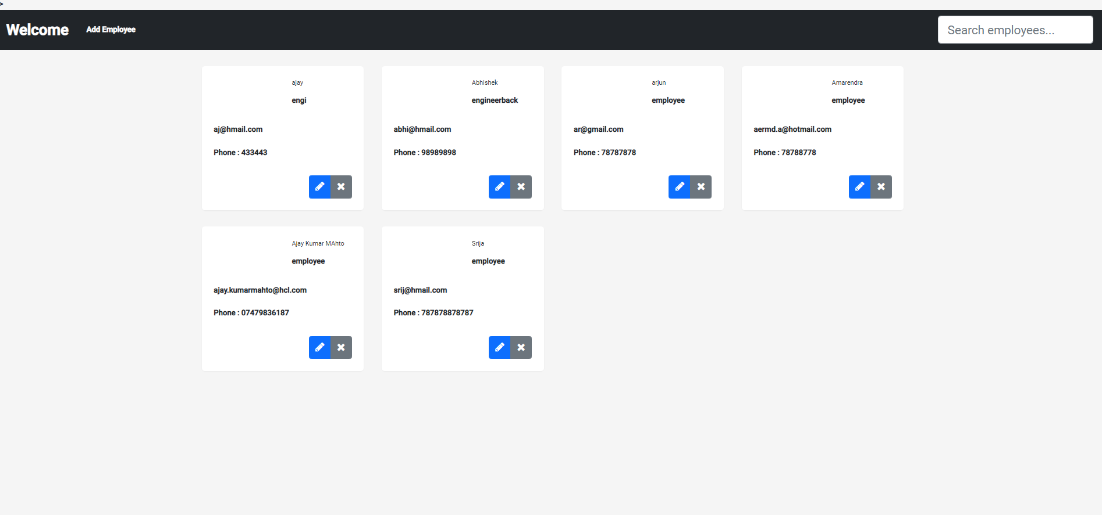
Employee-Details

Slide 22

Future Enhancements
We will update more the security system.
Separate page for guest users.
Create a comment box for your queries.

Slide 23
THANK YOU

